Slide 1
**** Project: Designing an App Part 1 ****
Lesson 3.3

Slide 2
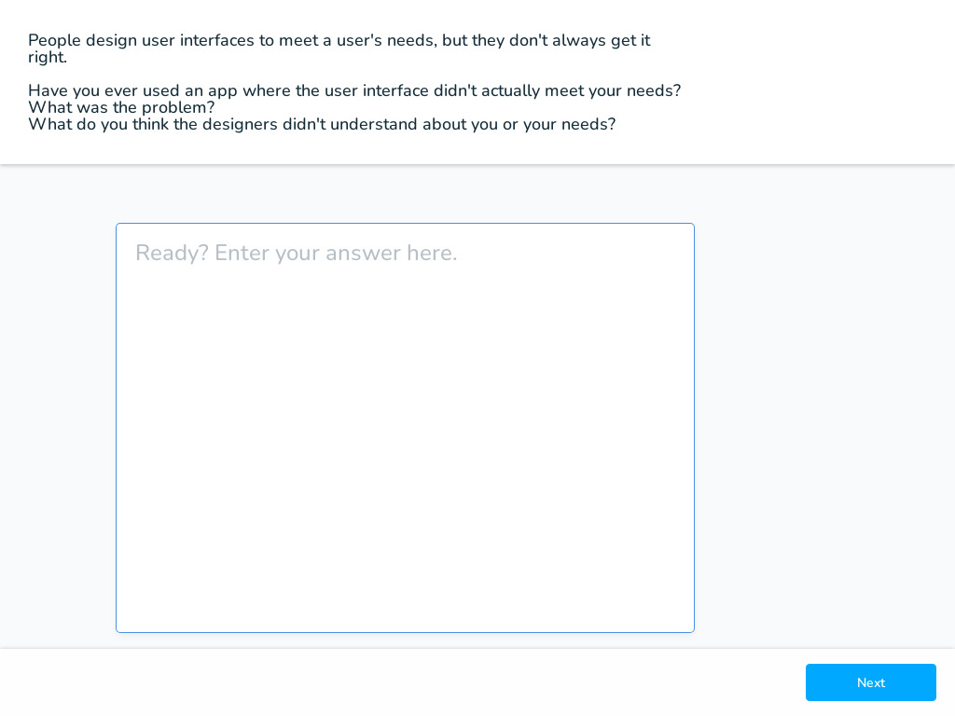
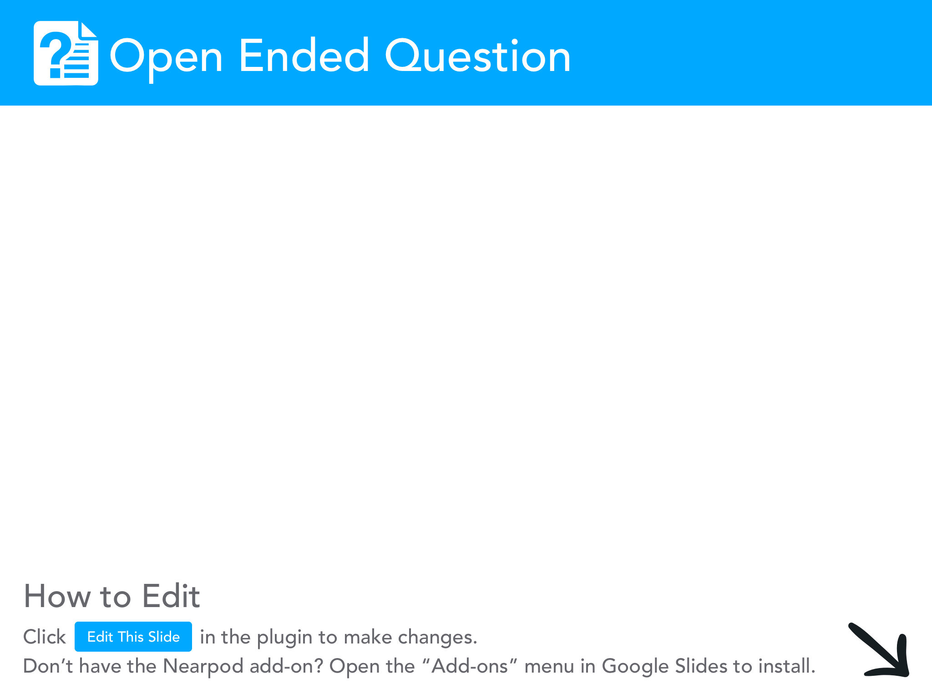

Slide 3
Design Mode
During the last lesson, we learned all about Design Mode.
Now you're going to start designing your own app that educates a user on some topic.
This is a project that will continue through the rest of the unit.

Slide 4

Step 1: Brainstorm Topic Ideas (2 minutes)
For this project, you will create an app that teaches your classmates about a topic you find interesting. Think about possible topics.
List AT LEAST three ideas at the bottom of the first page of your project guide.

Slide 5
Project Description
For this project you will work with a partner. Together you will create an app that teaches your classmates about some topic that you choose. Along the way you’ll learn how to use many of the features of App Lab as well as skills that will help you when building more apps throughout this class.

Slide 6
Choose a Partner
For this project you will need a partner to work with. Choose one now. Choose wisely.

Slide 7

Step 2: Choose One Topic (3 minutes)
Work with your partner to narrow down your ideas.
Pick a topic you are both interested in (it does not necessarily have to be one of the ones you brainstormed in step 1).

Slide 8
Avoid Bias in your Design
Collaboration is a big part of app development. Your team's diverse ideas will help make your app even better, because each partner can keep a lookout for bias.
Here's an example:
A team member puts in their app the phrase: "All teenagers work after school to earn spending money" because this is their experience - they work after school themselves. However, the other team member may not have an after school job, and because of this can point out the bias in that statement.
Collaboration is key to catching bias in your work!

Slide 9
Avoid Bias in your Design
Here's another example, this time in the design of an app.
A team wants to make an app to encourage girls to sign up for a summer camp. One team member assumes that because this app is aimed at girls, the background should be pink. A girl on the team points out that she does not like pink, and using that color in the design may represent bias.
As you think about your topics and start designing your apps, remember to keep an eye out for bias and use your teammates to keep you accountable!

Slide 10
Step 3: Survey Your Classmates
Group members should split up and each should join with at least 2 people from other groups to form "Focus Groups".
They should then complete Step 3 with this focus group before returning to their original partners.

Slide 11
Step 4: Design the User Interface
Design the interface for your app.
Sketch out the screens from your app on the handout.
Take pictures of your work, replace page 3 in your electronic planning guide with your picture.
You'll need to turn in your design!!!

Slide 12
Looking Forward
In the following lessons, you will continue to plan and create your apps.
What are we doing here? We are following a development process, which is similar to what developers use in the real world when creating their own apps. A development process breaks down the steps into small pieces - we've completed the first few today.
There are many different versions of the development process. Most use some combination of investigating and reflecting, designing, prototyping and testing. Development processes can be ordered like we have seen in the Activity Guide or more exploratory in nature. As we continue on through this project, reflect on the steps and consider how they help organize the process.

Slide 13
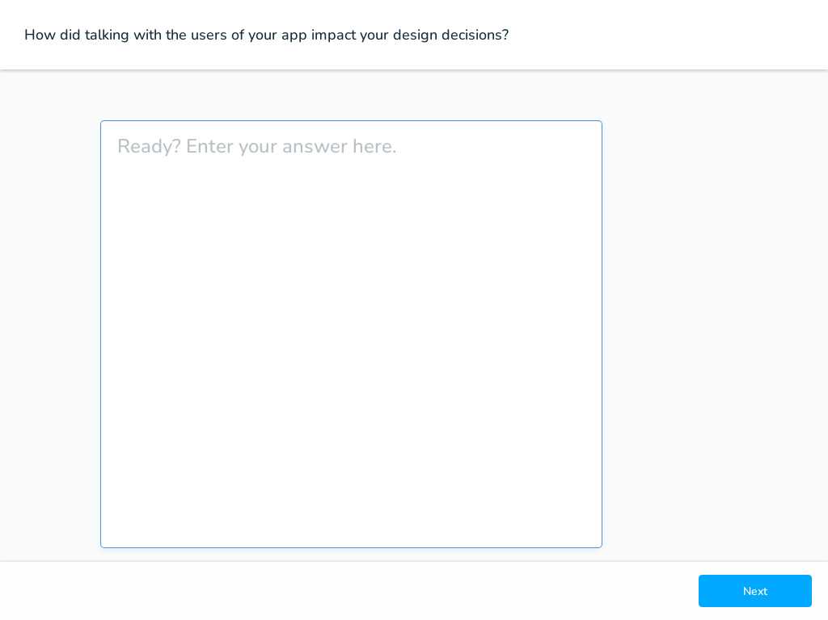

Slide 14
